Slide 1
Computer Hardware & Peripheral Manufacturer Sales Data Optimization

Slide 2
HEAD OFFICE Delhi
he's encountering difficulties in accessing regional sales data through monthly reports
Managers have provided numerous Excel files, but they're unable to extract meaningful insights from them
To address this, Bhavin Patel recommend to build a powerful Power BI dashboard.
Sales Insights Live
Bhavin Patel, as the Sales Director, is struggling to keep track of sales figures in a dynamically growing market.
Despite receiving insights and communication verbally from his manager,
What areas should we prioritize?
We embark on promotional and advertising efforts, how should we strategize our approach?

Slide 3
Introduction
Overview of Current Challenges:
Bhavin Patel, Sales Director, faces challenges in tracking sales figures
in a rapidly growing market.
Difficulty in accessing timely and accurate regional sales data.
Purpose of the Presentation:
To discuss the challenges, proposed solutions, and the implementation plan.
Proposed Solution:
Introduction of a Power BI Dashboard to streamline data analysis and reporting.

Slide 4

Proposed Solution
Introduction to Power BI:
Power BI as a powerful business analytics tool by Microsoft.
Benefits of Power BI:
Centralized data visualization.
Enhanced ability to generate insights quickly and accurately.
Key Features:
Interactive dashboards.
Real-time data updates.
Customizable reports.

Slide 5
Stores
Surge Stores
Excel Store
Electrical Sara Stores
Normad Stores

Slide 6

DASHBOARD BENEFITS
A picture Is worth a
thousand words.
Dashboard which makes Bhavin Patel life easier.
What was the trend ?
Email monthly no verbal communication
Sales Director can make data driven decision.

Slide 7

AIMS Grid
Purpose
Sales Director
Marketing Team
Customer Service Team
Data & Analytics Team
IT
Purpose
To unlock Sales insights that are not visible before for decision support & automate them to reduced manual time spent in data gathering.
Stack Holders
End Result
Success Criteris
An automated dashboard providing quick & latest sales insights in order to support data driven decision making.
Dashboard (S) uncovering sales order insights with latest data available
Sales team able to take better decisions & provide 10% Cost saving of Total Spend
Sales Analysts stop data gathering manually to save 20% of their business time and reinvest it value added activity.

Slide 8
Falcon
Data Master
Power bi Dashboard
Sales Management System
MY SQL
ETL

Slide 9
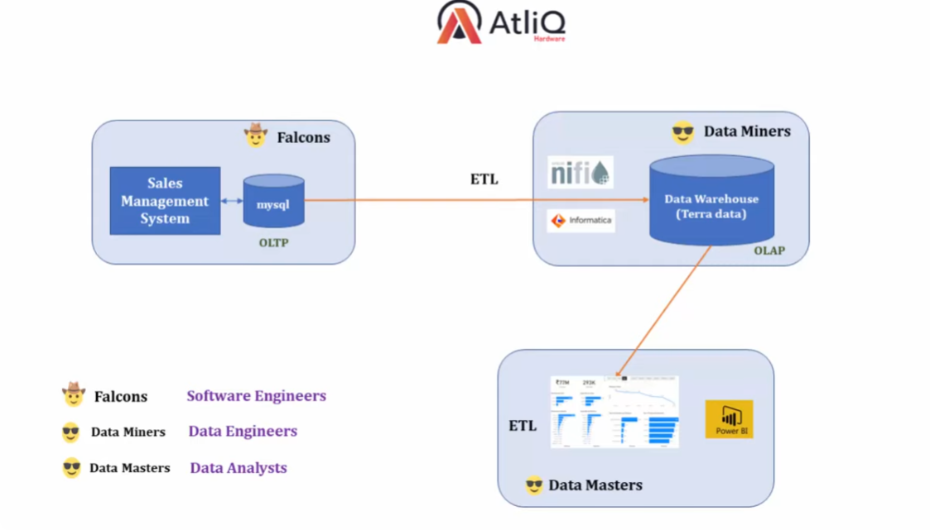

Slide 10

ETL (EXTRACT TRANSFORM AND LOAD)
Data warehouse

Slide 11
Data Cleaning and Extraction
Importance of Data Cleaning:
Ensures accuracy and reliability of data.
Process Overview:
Extracting data from multiple sources (customers, dates, markets, products).
Merging and cleaning data for consistency.
Techniques Used:
SQL queries for initial data extraction.
Power BI for final integration and visualization

Slide 12
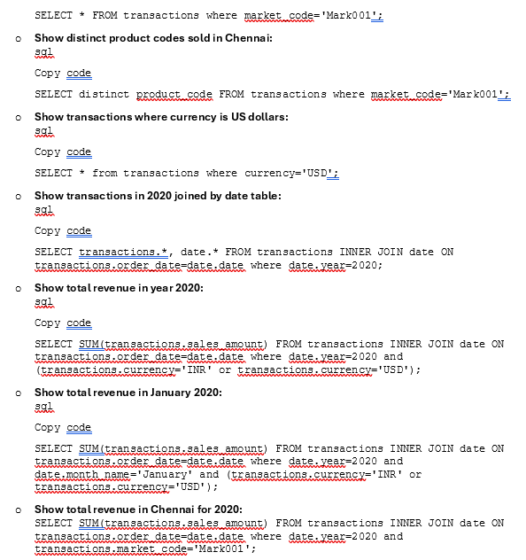

SQL Query
Data Analytics Approach

Slide 13

Expected Outcomes
Improved Data Accessibility:
Easy access to real-time regional sales data.
Enhanced Insights:
Ability to derive actionable insights from data.
Streamlined Reporting:
Simplified and efficient reporting processes.
Strategic Alignment:
Better alignment of promotional strategies with sales data for improved decision-making.

Slide 14
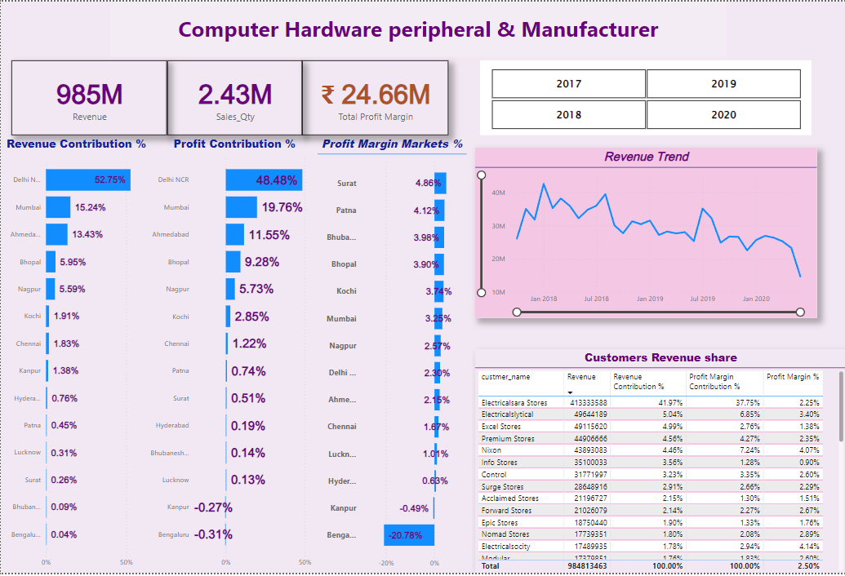
Power Bi Outcomes

